Slide 1
Recursive Language Definition and RE

Slide 2
Definition
Recursion
    When an entity is referred within its definition
    Recursive functions
        A function calls itself within its definition/body
Principles of recursion
    Define a base case
        For termination (in case of top down)
        For starting point (in case of bottom up)
    Define the recursive part in terms of base case

Slide 3
Continue…
  A recursive definition is characteristically a three steps process
  First, we specify some basic objects in the set
  Second, we give rules for constructing more objects in the set from the one we already know
  Third, we declare that no objects except those constructed in this way are allowed in the set

Slide 4
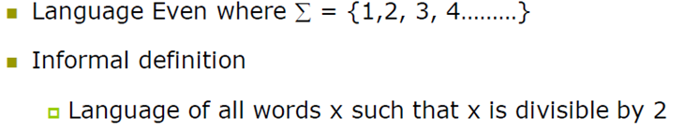


Example 1

Slide 5
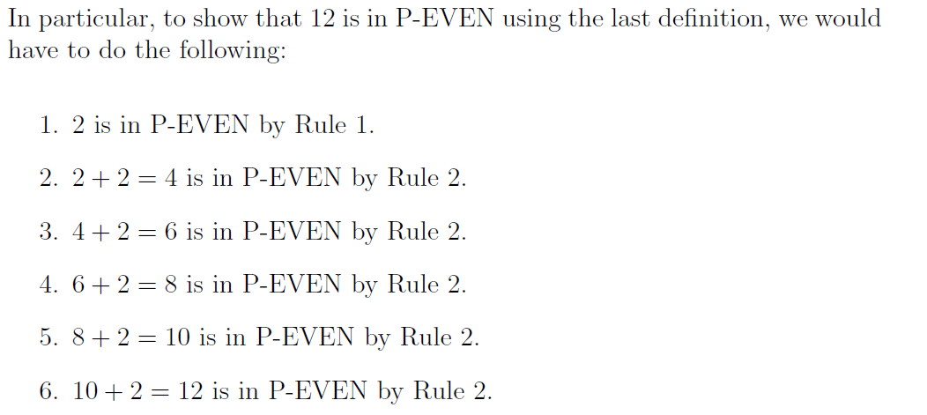
Continue…

Slide 6
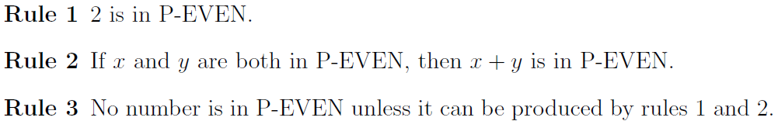
Second definition
We can make another definition for Positive EVEN as follows:

Slide 7
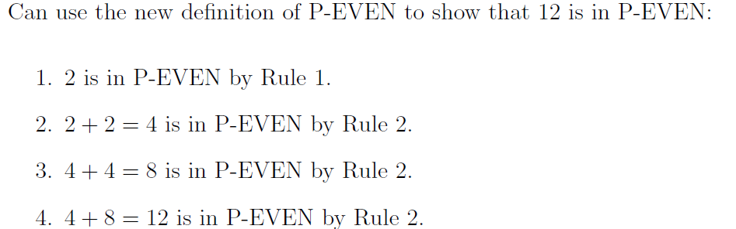
Show that 12 is in P-EVEN

Slide 8




Example 2

Slide 9



Example 3

Slide 10

Example 4

Slide 11
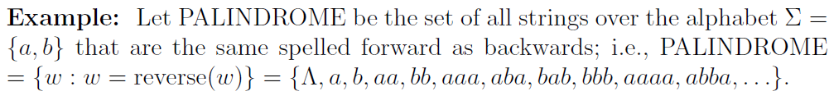
Its YOUR Turn…
Write RECURSIVE Definition for Palindrome

Slide 12
Defining the language factorial
??????

Slide 13

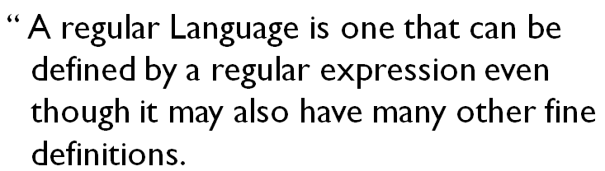
Regular Language

Slide 14
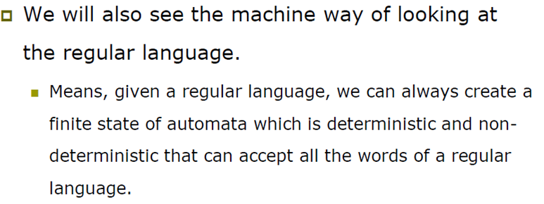
Continue….

Slide 15
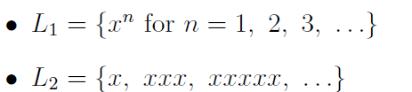
Method 3 (Regular Expressions)
Previously, we defined the languages:
But these are not very precise ways of defining languages.
So we now want to be very precise about how we define languages, and
we will do this using regular expressions.
  Languages that are associated with these regular expressions are called regular languages and are also said to be defined by a finite representation.
  Regular expressions are written in bold face letters and are a way of specifying the language

Slide 16
Defining Languages By New Methods
Regular Expressions
A regular Expression on the other hand, must take a very rigorous form as defined below recursively.
The Symbols that appear in RE are the Letters of the alphabet Σ, the symbol for
the null string ε, parenthesis, the star operator, and the plus sign.
Loosely speaking, a regular expression is a way of specifying a language in which
the only operations allowed are
    union (+),
    concatenation (or product),
    Kleene- closure,
    superscript-+.

Slide 17
Recursive definition of Regular Expression(RE)
Step 1: Every letter of Σ including Λ is a regular expression.
Step 2: If r1 and r2 are regular expressions then
                (r1)
                r1 r2
                r1 + r2 and
                r1*
are also regular expressions.
Step 3: Nothing else is a regular expression

Slide 18
Example
As discussed earlier that L1= {Λ, a, aa, aaa, …} or a* which generates {Λ, a, aa, aaa, …}
and
L2 = {a, aa, aaa, aaaa, …} or a+ which generates {a, aa, aaa, aaaa, …, }so the language and can simply be expressed by :
r1 : a* and
r2 : a+,
a* and a+ are called the regular expressions (RE) for L1 and L2 respectively.

Slide 19
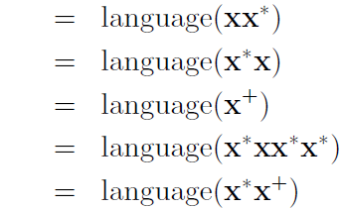
Example1:
Language L1 = {x, xx, xxx, xxxx, . . .}
Note that there are several different regular expressions associated with L1.

Slide 20
Example2:
consider another language L, of strings having exactly one a, defined over Σ = {a, b} . Write a RE for it
then it’s Regular Expression may be:
r = b*ab*
consider another language L, having strings of even length, defined over Σ = {a, b}
then it’s regular expression may be:
r = ((a+b)(a+b))*

Slide 21

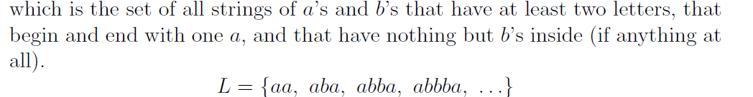
Example:
alphabet = {a, b}
Describe A language from above RE:

Slide 22
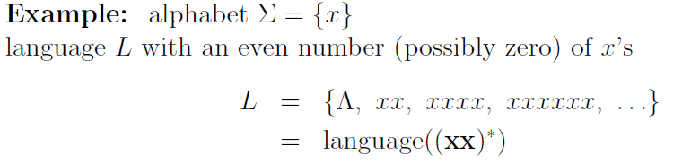
Example:

Slide 23
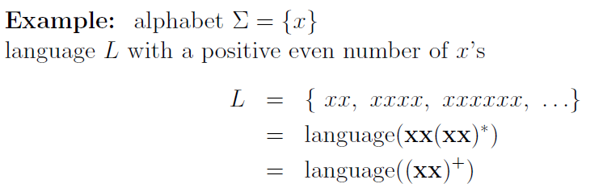
Example:

Slide 24
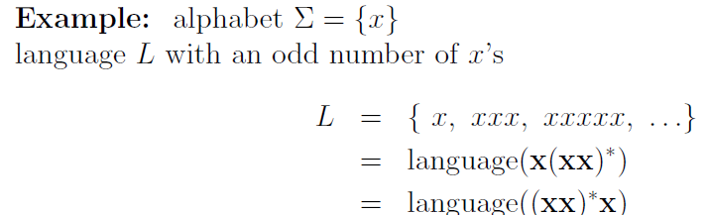

Example:

Slide 25
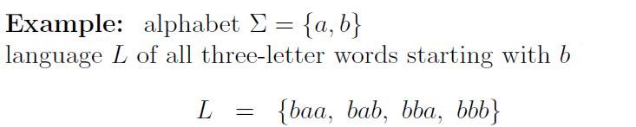

Example:

Slide 26
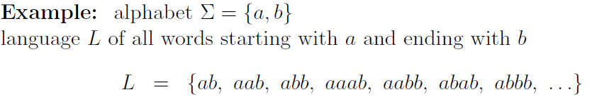

Slide 27



Slide 28
Theorem

